Slide 2
OOP stands for Object-Oriented Programming.
Object-Oriented Programming or OOPs refers to languages that use objects in programming, they use objects as a primary source to implement what is to happen in the code.
Objects are seen by the viewer or user, performing tasks assigned by you.

Slide 3
Object-oriented programming aims to implement real-world entities like inheritance, hiding, polymorphism etc. in programming.
The main aim of OOP is to bind together the data and the functions that operate on them so that no other part of the code can access this data except that function.

Slide 4
Prerequisites:-
Access Modifier: Defines the access type of the method i.e. from where it can be accessed in your application. In Java, there are 4 types of access specifiers:
public: Accessible in all classes in your application.
protected: Accessible within the package in which it is defined and in its subclass(es) (including subclasses declared outside the package).

Slide 5
private: Accessible only within the class in which it is defined.
default (declared/defined without using any modifier): Accessible within the same class and package within which its class is defined.

Slide 6
OOPS concepts are as follows:
Class
Object
Method
Pillars of OOPs
Abstraction
Encapsulation
Inheritance
Polymorphism
Compile-time polymorphism
Runtime polymorphism

Slide 7
Java - What are Classes and Objects?

Slide 8
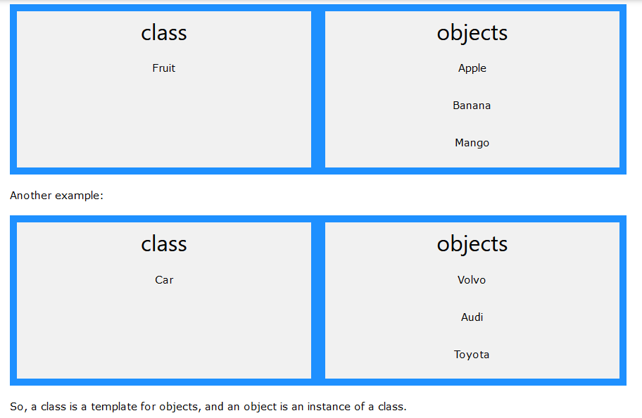

Slide 9
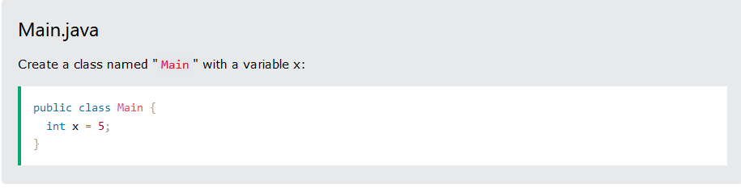
Create a Class
To create a class, use the keyword class:
Remember from the Java Syntax chapter that a class should always start with an uppercase first letter, and that the name of the java file should match the class name.

Slide 10
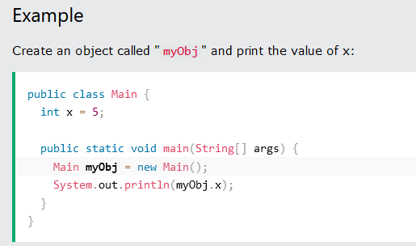
Create an Object
An object is created from a class.

Slide 11
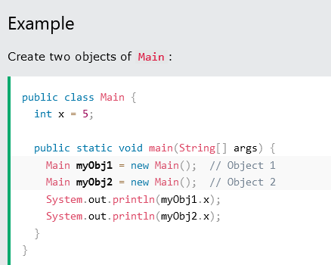
Multiple Objects
You can create multiple objects of one class:

Slide 12
Java Class Attributes
A variable defined within the class is called class attribute.
Accessing Attributes
You can access attributes by creating an object of the class, and by using the dot syntax (.):
Another term for class attributes is fields.
Similarly modification of attribute can be done by accessing with . operator and assigning value to it.

Slide 13
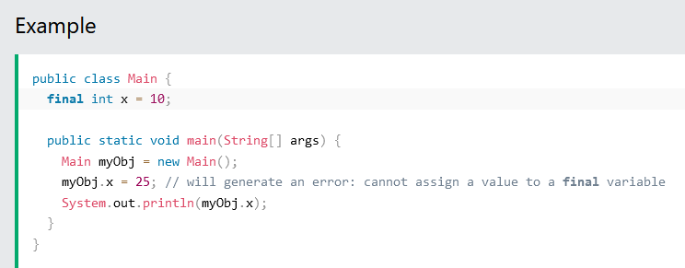
If you don't want the ability to override existing values, declare the attribute as final

Slide 14
Java Methods
A method is a block of code which only runs when it is called.
You can pass data, known as parameters, into a method.
Methods are used to perform certain actions, and they are also known as functions.
Why use methods? To reuse code: define the code once, and use it many times.

Slide 15
A method must be declared within a class. It is defined with the name of the method, followed by parentheses ().
Java provides some pre-defined methods, such as System.out.println()

Slide 16
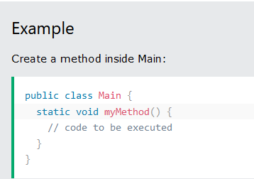
Example Explained
myMethod() is the name of the method
static means that the method belongs to the Main class and not an object of the Main class.

Slide 17
Static vs. Public
In the example above, we created a static method, which means that it can be accessed without creating an object of the class, unlike public, which can only be accessed by objects:

Slide 18
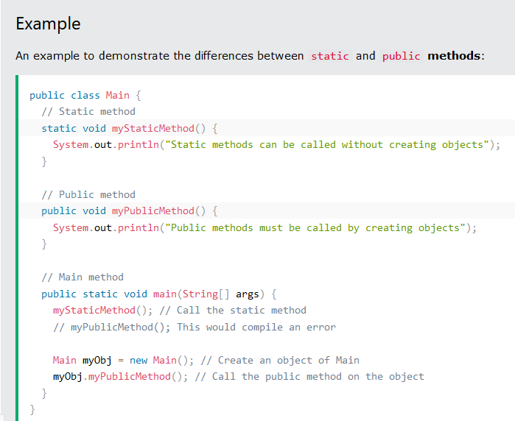

Slide 19
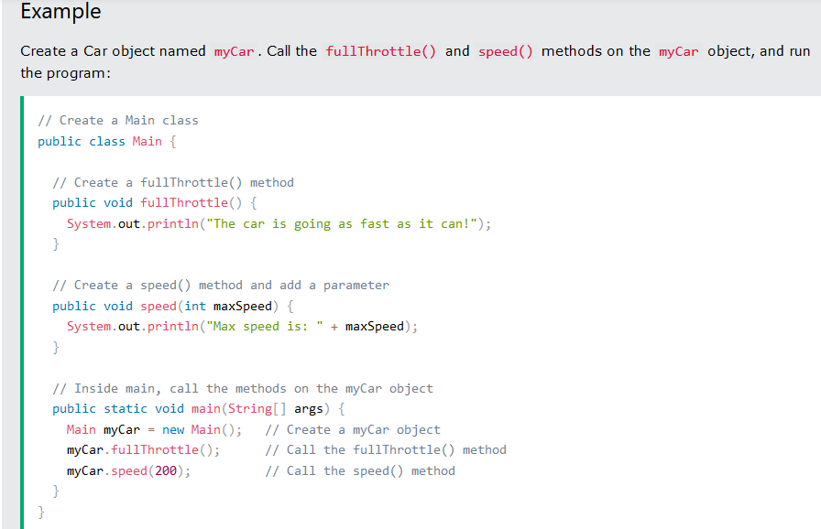

Slide 20
Java Constructors
A constructor in Java is a special method that is used to initialize objects. The constructor is called when an object of a class is created. It can be used to set initial values for object attributes:

Slide 21
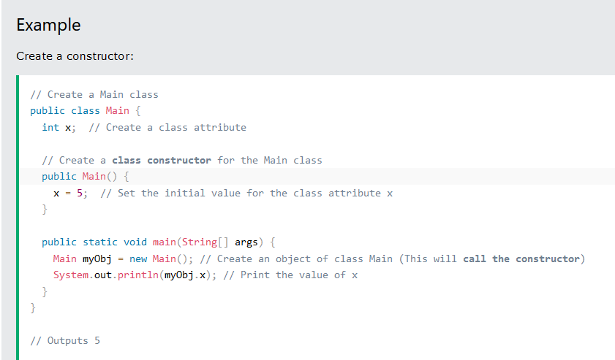

Slide 22
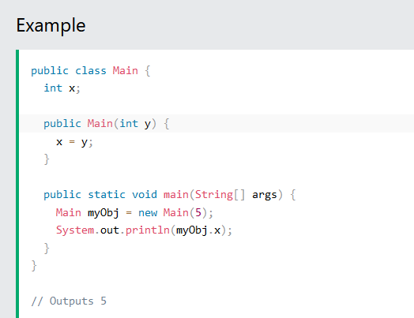
Constructor Parameters
Constructors can also take parameters, which is used to initialize attributes.

Slide 23
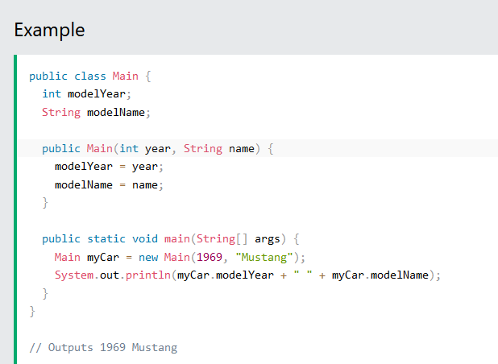

Slide 24
Modifiers
We divide modifiers into two groups:
Access Modifiers - controls the access level
Non-Access Modifiers - do not control access level, but provides other functionality

Slide 25
Access Modifiers
For classes, you can use either public or default:
Public:- The class is accessible by any other class
default The class is only accessible by classes in the same package. This is used when you don't specify a modifier.

Slide 26
For attributes, methods and constructors, you can use the one of the following:
Public:- The code is accessible for all classes
Private:- The code is only accessible within the declared class
Default:- The code is only accessible in the same package. This is used when you don't specify a modifier.
Protected:- The code is accessible in the same package and subclasses.

Slide 27
Non-Access Modifiers
For classes, you can use either final or abstract:
Final:- The class cannot be inherited by other classes
Abstract:- The class cannot be used to create objects (To access an abstract class, it must be inherited from another class. You will learn more about inheritance

Slide 28
For attributes and methods, you can use the one of the following:
Final:- Attributes and methods cannot be overridden/modified
Static:- Attributes and methods belongs to the class, rather than an object

Slide 29
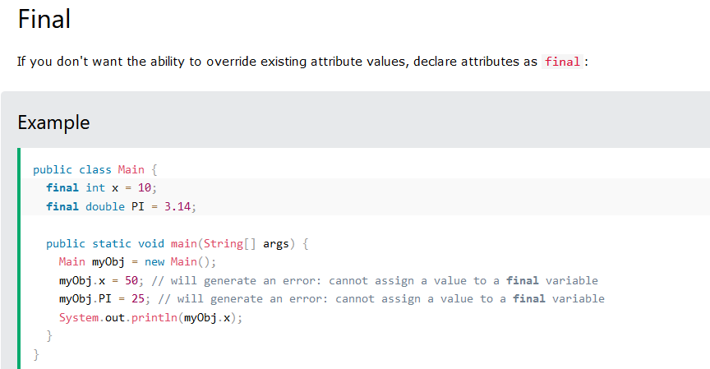

Slide 30
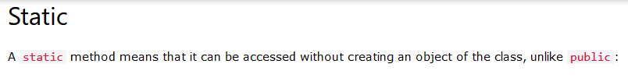
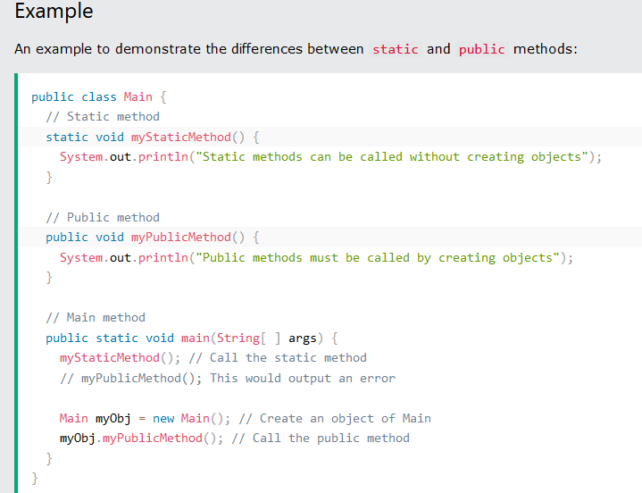

Slide 31
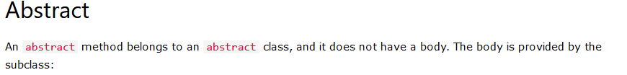
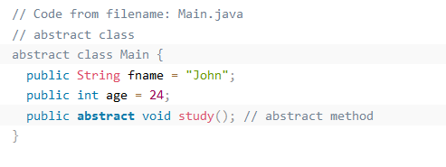
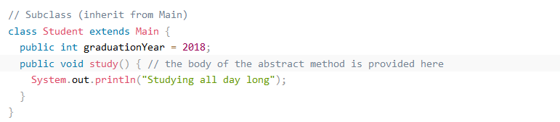

Slide 32
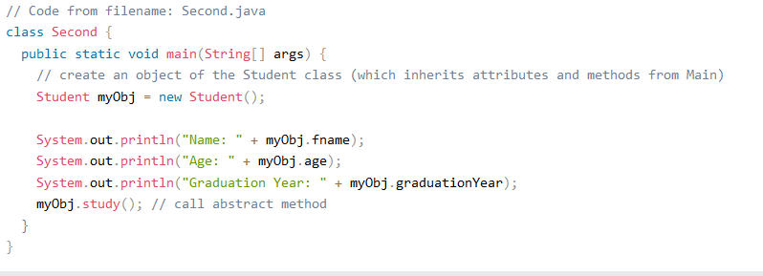

Slide 33
Practice Question 1
Snail
The purpose of this exercise is to train you in usage of
simple integer operations.
Estimated workload of this exercise is 30 min.
Description
Consider a snail travels up a tree a feet each day. Then
snail slides down b feet each night. Height of the tree is h
feet.
write a program that prints number of days for the snail to
reach the top of the tree.
Program reads a, b, h line by line. Input values are guaranteed to be
positive integers.
If the snail cannot reach the top of the tree, print the message Impossible.

Slide 34
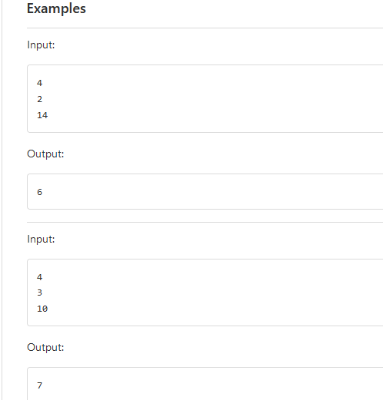

Slide 35
Practice Question 2
Pizza Split
The purpose of this exercise is to familiarize you with basic conditional and cyclic operations.
Estimated workload of this exercise is 20 minutes.
Description
Please, proceed to PizzaSplit class. The program must read two values from System.in:
number of people;
number of pieces per pizza.
It is guaranteed that this values are positive integers.
Then the program must print the minimum number of pizzas (not zero) so that everyone has an equal number of slices and no slice is left.

Slide 36
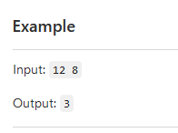

Slide 37
Encapsulation
The meaning of Encapsulation, is to make sure that "sensitive" data is hidden from users. To achieve this, you must:
declare class variables/attributes as private
provide public get and set methods to access and update the value of a private variable

Slide 38
Get and Set
Private variables can only be accessed within the same class (an outside class has no access to it). However, it is possible to access them if we provide public get and set methods.
The get method returns the variable value, and the set method sets the value.

Slide 39
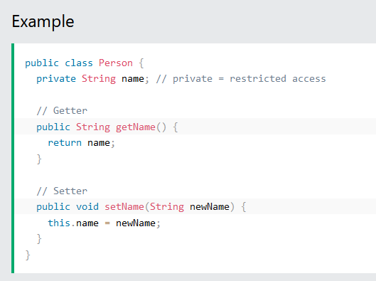

Slide 40
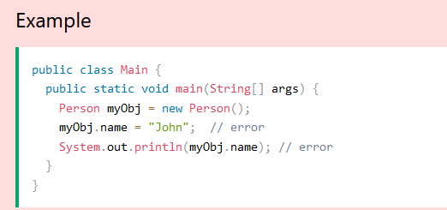

Slide 41
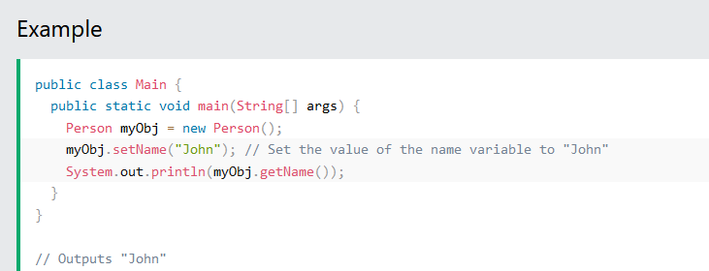

Slide 42
Why Encapsulation?
Better control of class attributes and methods
Class attributes can be made read-only (if you only use the get method), or write-only (if you only use the set method)
Flexible: the programmer can change one part of the code without affecting other parts
Increased security of data

Slide 43
Java Packages
A package in Java is used to group related classes. Think of it as a folder in a file directory. We use packages to avoid name conflicts, and to write a better maintainable code. Packages are divided into two categories:
Built-in Packages (packages from the Java API)
User-defined Packages (create your own packages)

Slide 44
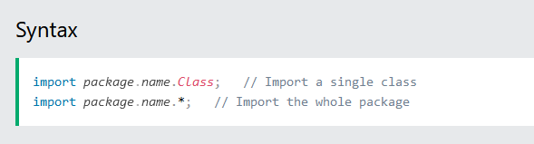
Built-in Packages
The Java API is a library of prewritten classes, that are free to use, included in the Java Development Environment.

Slide 45
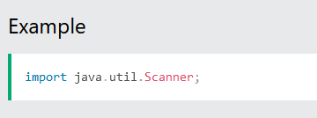
Import a Class
If you find a class you want to use, for example, the Scanner class, which is used to get user input, write the following code:

Slide 46
In the example above, java.util is a package, while Scanner is a class of the java.util package.
To use the Scanner class, create an object of the class and use any of the available methods found in the Scanner class documentation. In our example, we will use the nextLine() method, which is used to read a complete line:

Slide 47
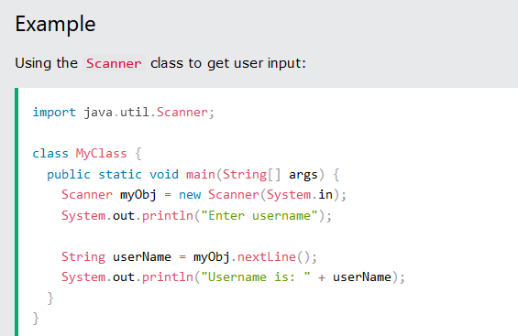

Slide 48
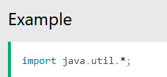
Import a Package
There are many packages to choose from. In the previous example, we used the Scanner class from the java.util package. This package also contains date and time facilities, random-number generator and other utility classes.

Slide 49
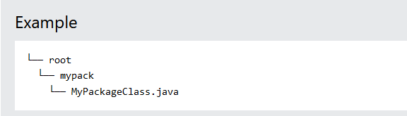
User-defined Packages
To create your own package, you need to understand that Java uses a file system directory to store them. Just like folders on your computer:

Slide 50
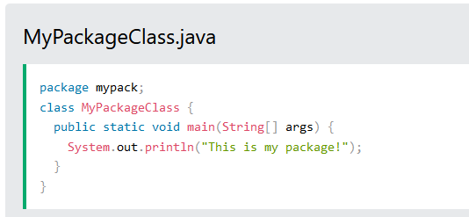
To create a package, use the package keyword:

Slide 51
Java Inheritance
Java Inheritance (Subclass and Superclass)
In Java, it is possible to inherit attributes and methods from one class to another. We group the "inheritance concept" into two categories:
subclass (child) - the class that inherits from another class
superclass (parent) - the class being inherited from
To inherit from a class, use the extends keyword.

Slide 52
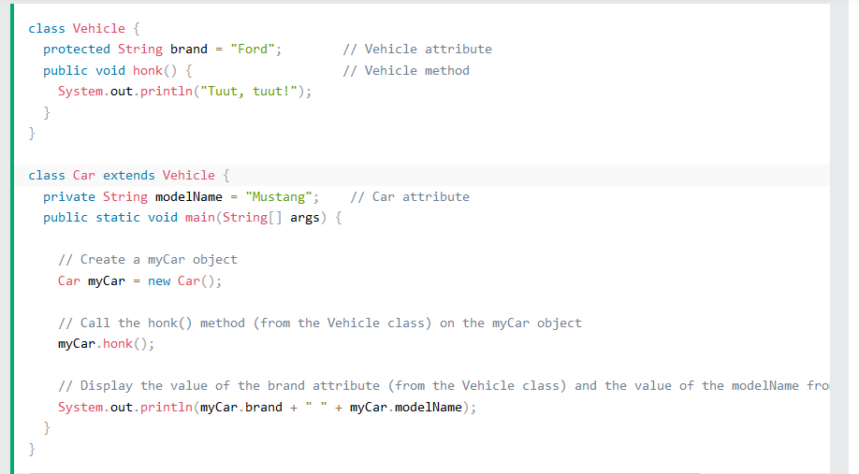
In the example below, the Car class (subclass) inherits the attributes and methods from the Vehicle class (superclass):

Slide 53
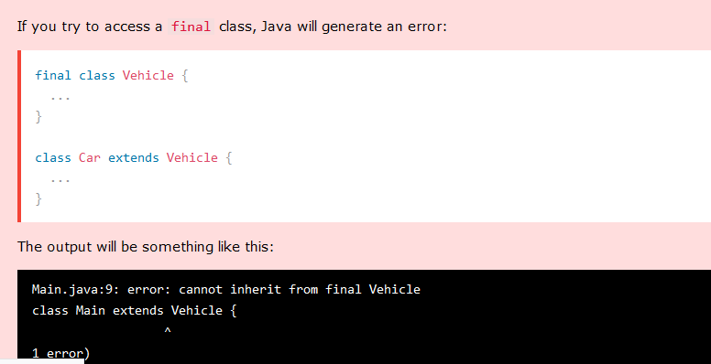
The final Keyword
If you don't want other classes to inherit from a class, use the final keyword:

Slide 54
Java Polymorphism
Polymorphism means "many forms", and it occurs when we have many classes that are related to each other by inheritance.
Inheritance lets us inherit attributes and methods from another class. Polymorphism uses those methods to perform different tasks. This allows us to perform a single action in different ways.

Slide 55
For example, think of a superclass called Animal that has a method called animalSound(). Subclasses of Animals could be Pigs, Cats, Dogs, Birds - And they also have their own implementation of an animal sound (the pig oinks, and the cat meows, etc.)

Slide 56
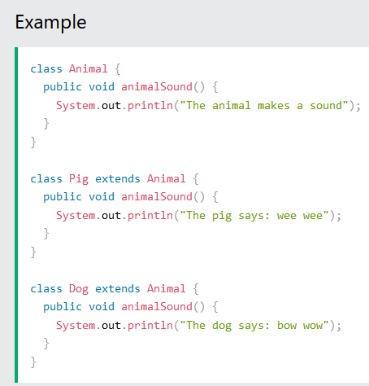
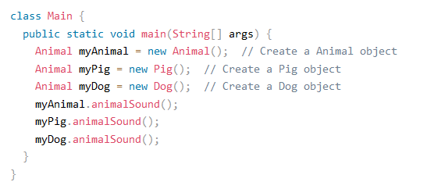

Slide 57
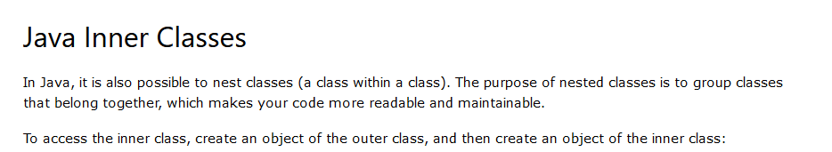
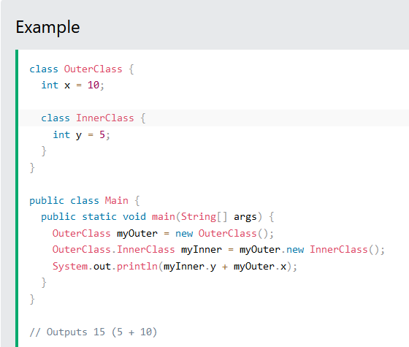

Slide 58
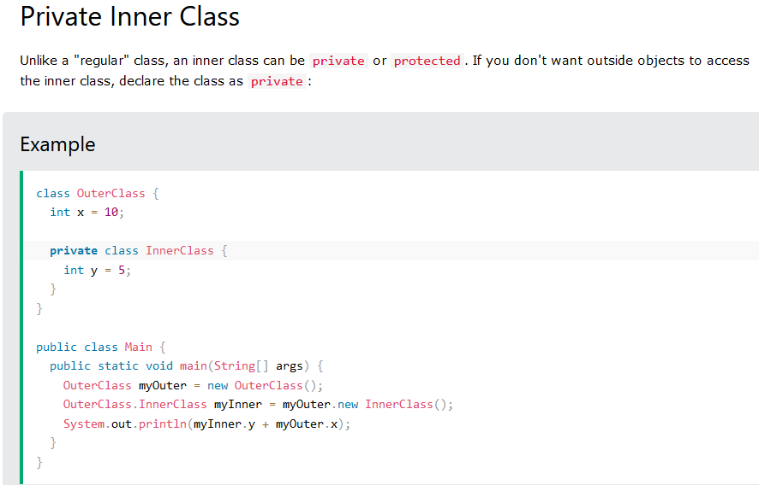


Slide 59
